Slide 1

Hotel Aggregator Analysis Using Power BI

Slide 2
1. Project Overview
This internship project aims to analyze a dataset of hotel aggregator listings using Power BI. The dataset comprises various attributes related to listings, hosts, reviews, and availability. The objective is to create comprehensive visualizations and insights that shed light on trends, patterns, and factors influencing the performance of listings. Through Power BI, I explored key metrics such as pricing, availability, host characteristics, and review scores to derive actionable insights for improving the overall quality and competitiveness of the listings.

Slide 3
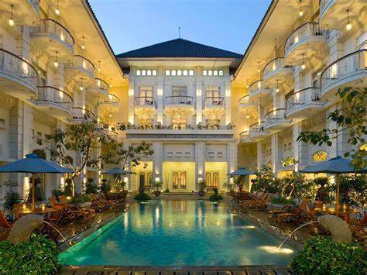
2. Project Objectives
Geographical Insights.
Pricing and Availability Analysis.
Host Performance.
Review Scores and Guest Satisfaction.
Property Type and Room Analysis.

Slide 4
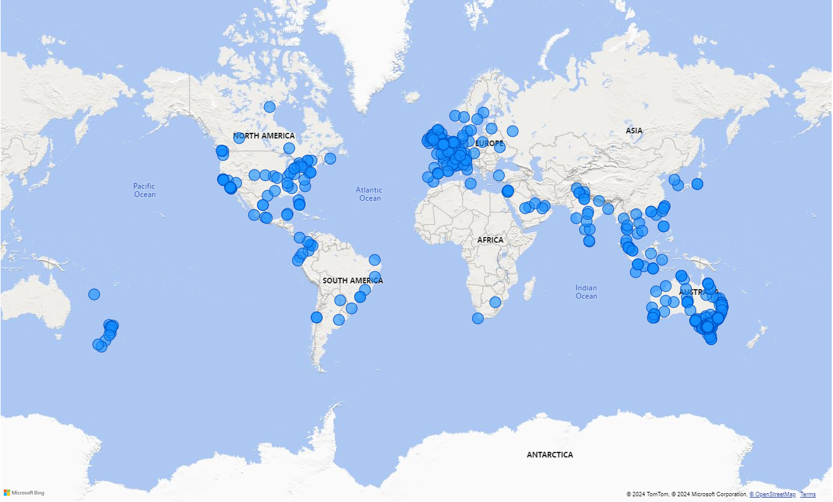
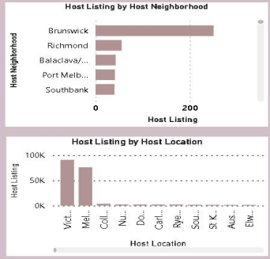
Geographical Insights

Slide 5
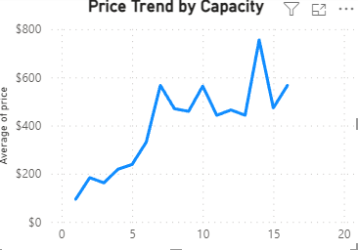
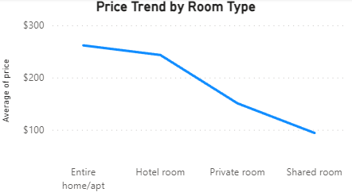
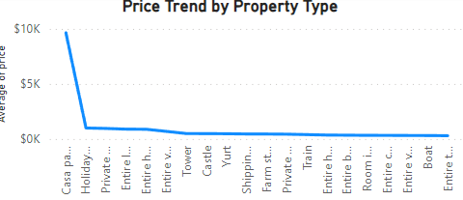
Pricing and Availability Analysis

Slide 6
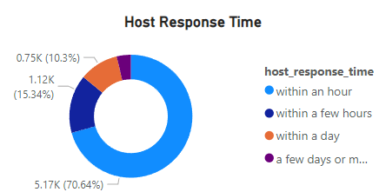
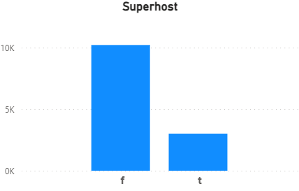
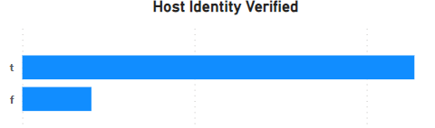
Host Performance

Slide 7
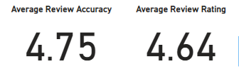
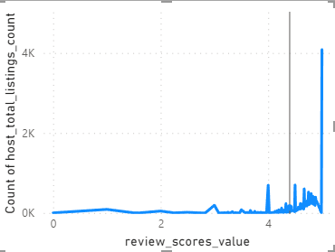
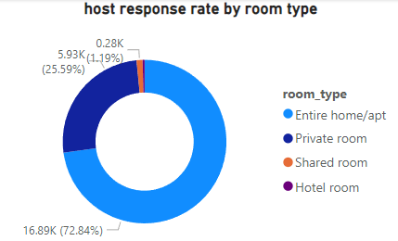
Review Scores and Guest Satisfaction

Slide 8
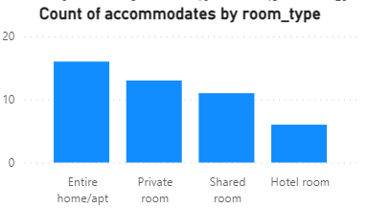
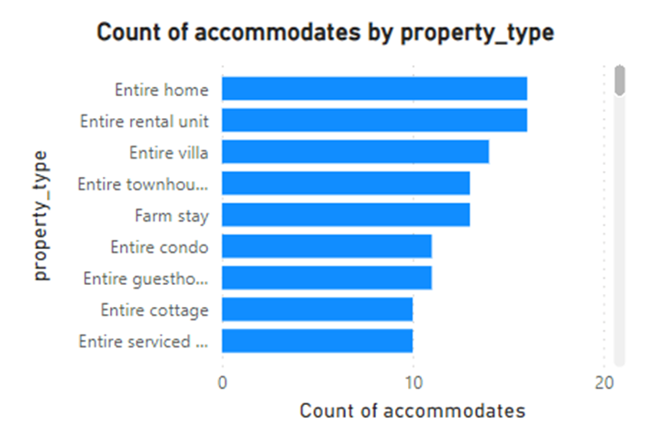
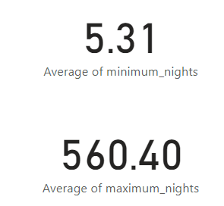
Property Type and Room Analysis

Slide 9
Key Insights and Recomendations
➢ Melbourne,Australia boasts the highest number of listings.
➢ Guest satisfaction is influenced by several factors, including
cleanliness, amenities, communication, and the overall experience.
➢ There exists a strong and evident proportional relationship between
the total count of reviews and the total number of listings. This
correlation provides hosts with more opportunities for ratings, thereby
increasing their popularity

Slide 10

➢ The capacity of accommodation does not necessarily correlate proportionally with the price. ➢ Entire room types are typically the most affordable option available. ➢ The super host status is not influenced by the response rate. ➢ Yurts, barns, boats, and buses have a limited presence in the listings, indicating an opportunity to diversify offerings.

